Slide 1
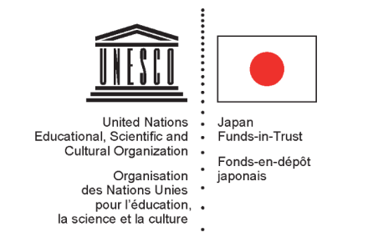
COMprehensive Program to Enhance Technology, Engineering and ScieNCE Education (COMPETENCE) in Asia
The Role and Contribution of Higher Education Institutions
Shahbaz KHAN Deputy Director and Senior Science Program Specialist

Slide 2
Project title
COMprehensive Program to Enhance Technology, Engineering and ScieNCE Education (COMPETENCE) in Asia:
The Role and Contribution of Higher Education Institutions
Overall Developmental Goal
To engage individuals, academic institutions and governments to develop and use Science and Engineering Education as a fundamental basis for Sustainable Development in Asia and the Pacific
Project Objective
Rethinking science and engineering education to put it in the context of Education for Sustainable Development

Slide 3
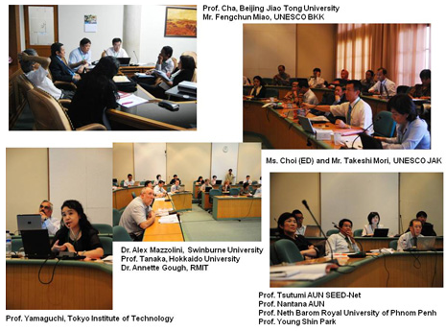
COMPETENCE (Phase 1) January – December 2010
The Regional Framework Meeting was held on 18-19 May, 2010 in Yogyakarta, to develop a framework for science education in the context of sustainable development that would guide the development of regional and national projects in science education in the Asia-Pacific.
One day “Workshop of Core Team to Develop a Framework for Science
Education in the Context of ESD” was organized on 24 August 2010.
This core experts meeting was to finalize the framework paper.
Course outlines for 2 model
e-learning courses, on the topics
of Sustainability science and
Energy for Sustainable Development
In Country Pilot Project : Bangladesh,
Cambodia and Timor Leste
Notes:
In year 1, the project organized the framework meeting to develop a regional framework and programme of action for science education for the context of EST. The framework paper has been preparing for the following activities of COMPETENCE in subsequent years. The project also organized two experts meeting to develop model courses on Sustainability Science and Energy for Sustainable Development.
In-country pilot projects – Year 1 of the project is expected to end with project proposals written by the consultants based on their review of the state of science education and needs assessment in 3 pilot countries, Bangladesh, Cambodia and Timor Leste,

Slide 4
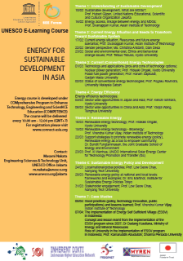
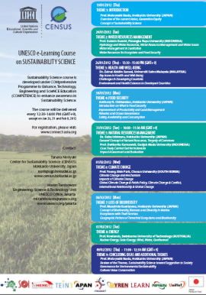
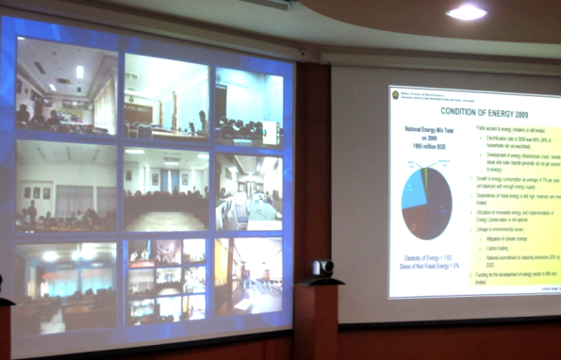
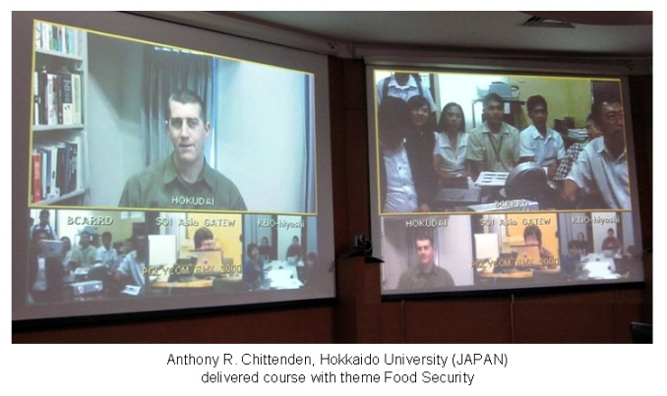
COMPETENCE (Phase 2) January 2011 – April 2012
Pilot project proposals on Science Higher Education for Timor Leste, Bangladesh and Cambodia were developed based on two assessment papers and STEPAN paper “Review of Cambodia's science and technology policy and science, technology education and mathematics (STEM) education policy and practice.” Two pilot projects have been implemented.
Energy for Sustainable Development in Asia and Sustainability Science was developed and delivered .
Energy for Sustainable Development in Asia broadcasted on February 2011 with
600 participants from 23 countries.
Sustainability Science delivered on January 2012 with
225 participants from 21 countries
Notes:
Review and refinement of the project proposals, and start of pilot implementation of the pilot projects that had been described in the proposals
Sustainability Science Course
The course covered comprehensive framework of sustainability, such as concepts, sustainable resource use (energy, water, food, materials, etc.), institutions, economy, social capital and human capital.

Slide 5
COMPETENCE ( Phase 3) May 2012 – May 2013
Review Meeting on COMPETENCE was held on 7-8 January 2013 in Bangkok, Thailand
To review COMPETENCE activities for two years and discuss the way forward, recommendations for further COMPETENCE activities and a possible expansion of programme scope, the integration of COMPETENCE into the Sustainability Science Initiative, which UNESCO might adopt as a new paradigm for sustainable development, and how to incorporate COMPETENCE in UNESCO’s overall priorities.
Model Interdisciplinary Courses : Energy for Sustainable Development and SEEForum
To localize the Energy for Sustainable Development course. SEEForum, Prof. Ohgaki and Kyoto University teamed up with local universities that have competence to embed the course in their own curricula to adapt and sustain it.
The E-learning course of Energy for Sustainable Development has started to be developed and conducted in Vietnam and Lao PDR.
Notes:
The meeting also aimed to develop an outline of the proposed courses, and recommend collaborative approaches that could be pursued by the project to build on ongoing similar or related initiatives pursued by other relevant networks in the region

Slide 6
Rethinking Science Education in the Context of ESD In-country pilot projects
Timor Leste
Sustainability and Higher Learning for Sustainable Development in Timor Leste
Cambodia
National Science, Technology and Innovation Policy (NPSTI)
Bangladesh
Assessment of the state of Science education in Bangladesh towards a regional collaboration on an innovative interdisciplinary program in Education for Sustainable Development (ESD)
Notes:
6

Slide 7
http://connect-asia.org
COllaboration for Network-eNabled Education, Culture, Technology and science

Slide 8
The 22th International Hydrological Programme (IHP) course was delivered through SOI. 85 participants joined the course through NRENs.
SpringerLink online database of academic papers in all academic fields for University National of Timor Leste (UNTL) from 2010 – 2012.
Year | Total of Usage
Oct - Dec 2010 | 28
Jan - Dec 2011 | 719
Jan - Dec 2012 | 846
* Usage of downloaded books and journals.
Notes:
IHP
The course was composed of a series of lectures and practice sessions which introduced the basics of precipitation retrieval from space data and current global precipitation maps and include the accuracy. The course was attended by 13 participants from 10 countries (Cambodia, China, Ghana, Lao PDR, Mongolia, Myanmar, Philippines, Tanzania, Thailand, and USA)
Springerlink
The We are trying to justify the continuous use of SpringerLink in TL. Having SpringerLink greatly benefits Timor Leste. It’s obvious, but convincing the donor is a different story.
8

Slide 9
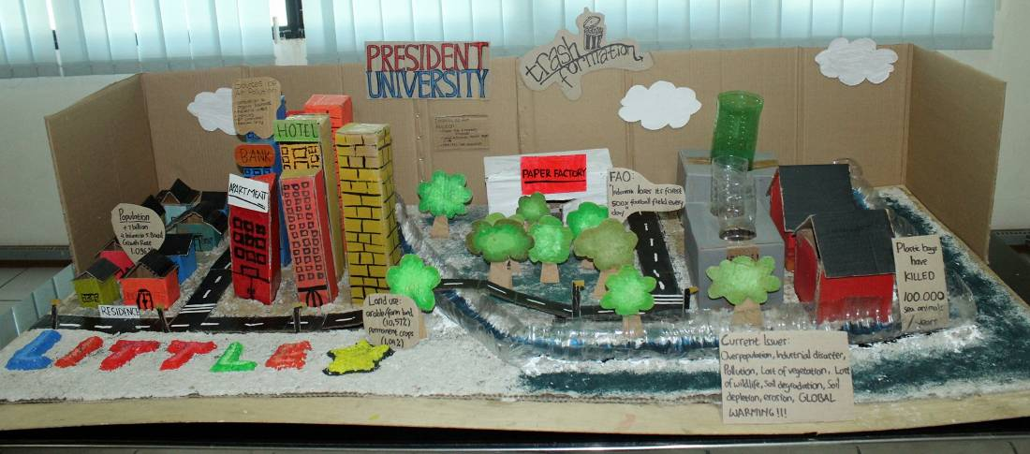
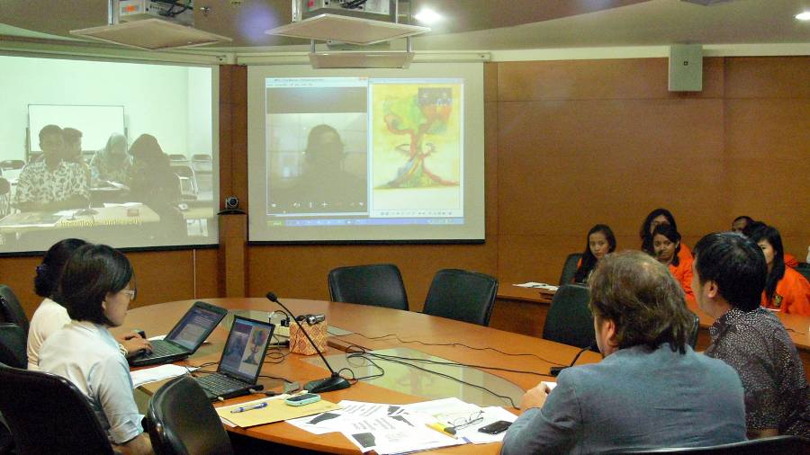
Visibility event with
CONNECT-Asia
Rio+20: “My Idea of Sustainable Lifestyle” (MISL)
The aim of this event is to gather ideas from youth about how they want their future to be – in concurrence with sustainable development ideas of Rio+20 Conference
Notes:
The live event at DIKTI Teleconference Studio, with collaboration with United Nations Information Centre (UNIC) Jakarta, and UNESCO Youth Desk
5 students from different universities in Indonesia were selected to present their ideas in the live event.
We hope that youth will be more encouraged to take active roles in living a green lifestyle from now on in order to create a better future
9

Slide 10
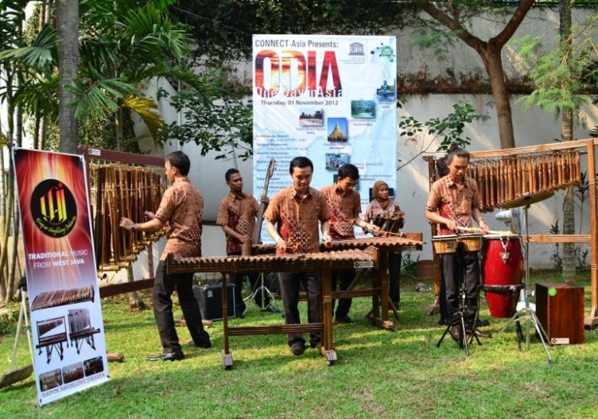
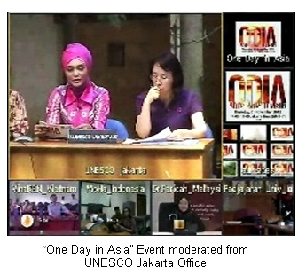
One Day in Asia (ODIA) Event
The idea was to utilize the power of CONNECT-Asia ICT networks and mobile technology to livestream a broadcast from UNESCO World Heritage sites located in multiple countries. Hundreds of viewers joined the event by watching the live broadcast from video conference and USTREAM live streaming.
Notes:
The participants are from Nepal, Myanmar, Indonesia, Malaysia, Japan, South Korea, Australia and England
Hundreds of viewers joined the event by watching the live broadcast from video conference and USTREAM live streaming
With the cooperation of our NREN partners, UNESCO successfully livestreamed broadcast from 8 countries’ cultural heritage sites on One Day in Asia (ODIA) event in November 1st, 2012. Nepal, Myanmar, indonesia, Malaysia, Japan, South Korea, Australia and England was to utilize the power of CONNECT-Asia ICT networks and mobile technology to livestreamed a broadcast from UNESCO World Heritage sites located in this multiple countries.
10

Slide 11
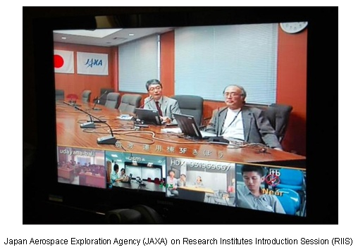
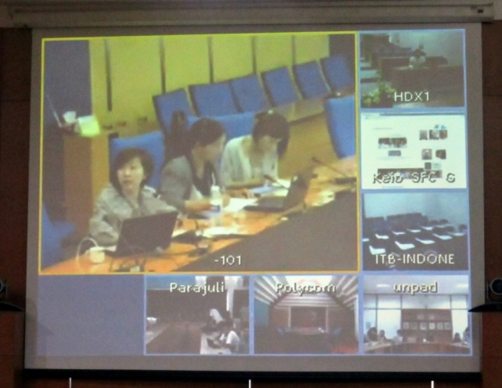
RIIS (Research Institutes Introduction Session)
National Science and Technology Development Agency (NSTDA), Thailand (August 2012)
National Center for Genetic Engineering and Biotechnology (BIOTEC), Thailand (September 2012)
Japan Aerospace Exploration Agency (JAXA), Japan (October 2012)
The National Institute of Advanced Industrial Science and Technology (AIST), Japan (January 2013)
Notes:
Research Institutes Introduction Session (RIIS), is a series of interactive e-learning sessions which will introduce Asia’s leading scientific research institutions to young people to cultivate their interest in related fields, and to graduate students and prospective postdoctorals to learn about scientific research work in Asia
NEXT event : Space Seeds for Asian Future will be held on 22 July 2013. Through the SSAF 2013 programme intend to promote better understanding and gain experience about the use of KIBO the largest single International Space Station (ISS) Module

Slide 12
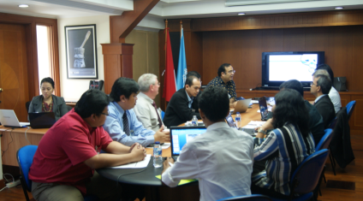
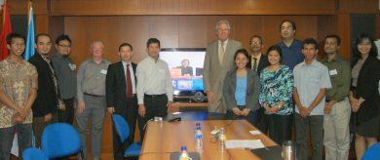
The 6th COllaboration for Network-eNabled Education, Culture, Technology and science (CONNECT) Asia meeting on 03 - 04 July 2013 in Jakarta, Indonesia.
Main focused on "Maximizing the use of e-learning methods in the formal education curriculum in each NREN partners region".
Key Points of the meeting :
Continuity of actions and visibility of CONNECT Asia
Synthesis and sharing of experiences for other countries and for other regions (Asian countries and Africa)
Launching of a UNESCO - CONNECT Asia MasterClass
Notes:
The meeting noted that the creation of a central repository was discussed and Keio has offered on the establishment of a portal site after the format has been agreed by the members. In addition the portal site will include a guideline for OER to encourage partners to share their materials.
Enrich CONNECT Asia with content
Making Open Source material available more widely

Slide 13
List of E-Learning Courses
and Events
Renewable Energy Policy and Planning (2007)
E3i (Energy, Economy and Environment) Self-Sustainable Eco-village concept (2008)
E3i village Application (2009)
UNESCO Lecture Series for Education, Science and Culture (2008 & 2009)
Grassroots Innovation Management (2009)
Capacity building for university-industry partnership and technology management (2009)
Renewable Energy Policy and Planning (January, 2010)
Financing renewable energy projects (video tele-conference) (2008)
HIV/AIDS prevention education (2009)
IHP Training Courses (2009-ongoing)
Climate Change and Water Resource Management (2010)
Energy for Sustainable Development in Asia (2011)
Engineering courses in Bahasa Indonesia (for the National University of Timor Leste, 2011)
Connectivity Tele Seminar Event (2011)
Agorasia (2012)
Sustainability Science (2012)
Rio+20: “My Idea of Sustainable Lifestyle” (2012)
Mozilla Event in ITB (2012)
UN4U Campaign “The Future We Want for All” in ITB (2012)
UN Secretary General Speech in Timor Leste (2012)
Research Institutes Introduction Sessions (2012-ongoing)
One Day in Asia (2012)
Consumers’ Acceptance and Behavior of E-commerce in Asia and Cross Borders (2013)
Space Seeds for Asian Future (2013)
Agorasia 2 (2013)
MasterClass to Come!
Notes:
We usually announce new courses in our Connect Asia website connect-asia.org, as well as in our social media (Facebook and Twitter)
13

Slide 14
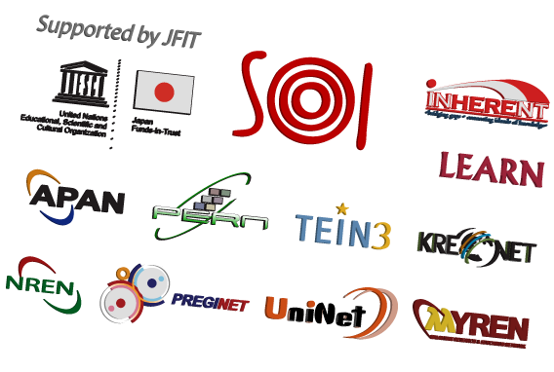
Collaborations
Notes:
CONNECT Asia , as a group of national, sub-regional, and regional ICT networks, actively contributes to the improvement of education and research in Asia and the Pacific.

Slide 15
Related URL
COMPETENCE Project
http://competence-program.asia/
Schedule, update, misc announcement
http://connect-asia.org
Presentation files and videos of E-learning course:
http://e-learning.connect-asia.org/
CONNECT Asia Youtube
http://www.youtube.com/user/CONNECTAsia
UNESCO Jakarta
www.unesco.org/jakarta/
THANK YOU
Notes:
15

